Slide 1
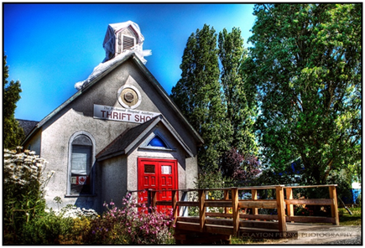
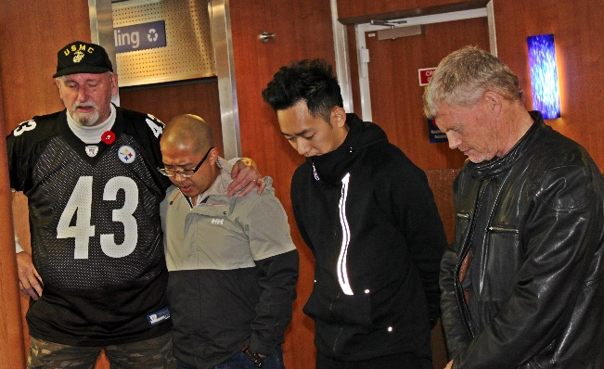
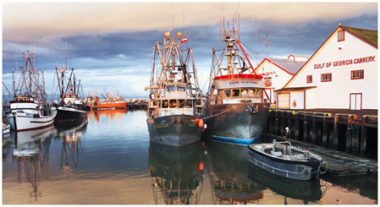
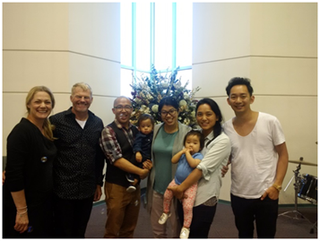
Steveston Project
PLEASE PRAY that God would:
Continue to bring the right people and those He has prepared for this new work
Grant us boldness to follow the lead of Spirit to enter into new relationships and networks
Lead us to be spiritually receptive to people
Lpd Church of the week

