Slide 1

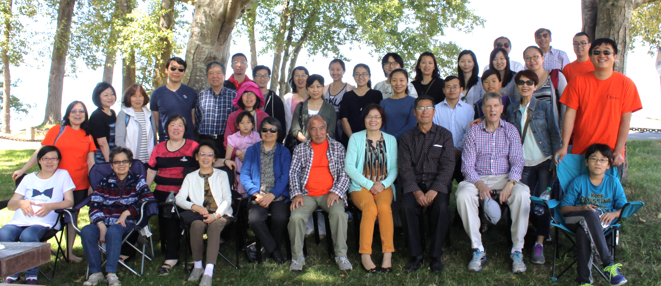
LPD church of the week
Please pray for:
  God’s guidance on hiring new pastoral staff
  Christmas event called “The Most Precious Gift” as an opportunity of sharing the gospel
  The development of youth group
  The purchase of a new church building
  TWU Chinese student ministry
Richmond Caring Centre
3rd floor 7000 Minoru Boulevard, Richmond

