Slide 1
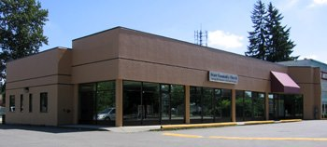
Grace Community Church
LPD Church of the Week
Please join in prayer for Grace Community Church:
That leadership needs would be filled
For newcomers to grow and integrate
Praise for the elderly who are an integral part of the church family
Praise for the people God has brought who are engaging in ministry
That God would be at work in people during the Christmas Eve service as they hear the gospel
Praise for the family of believers as they fellowship together over a meal twice a month
12240 Harris Rd, Pitt Meadows

