Slide 1
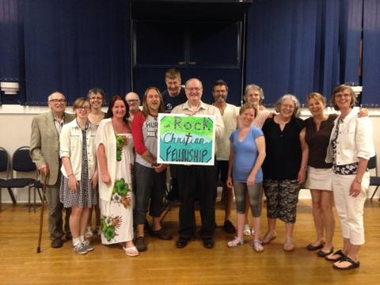
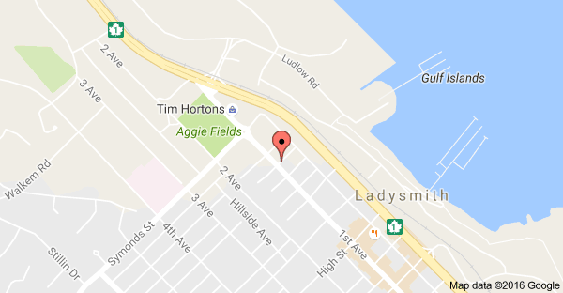
The Rock Christian Fellowship
Pray for us during this season we have a number of outreaches going on until the end of January.
The Church is sponsoring a Christmas event called the Celebration of Light to help the Ladysmith Food Bank and Soup Kitchen.
Last year's event raised approx. $8,000 and gathered a ton of food to help the needy in the community.
LPD church of the week

