Slide 1
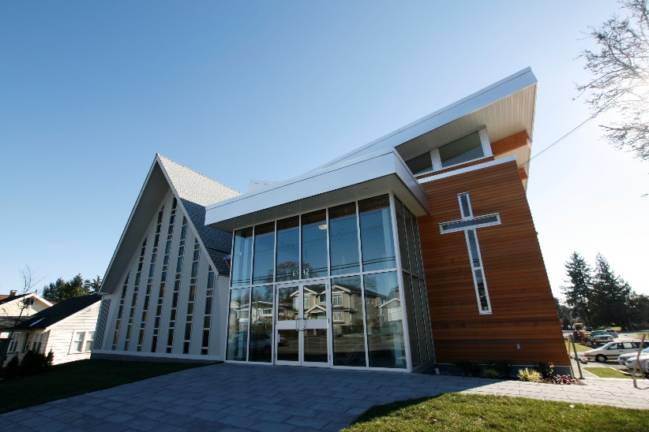
Burnaby Chinese EFC
LPD Church of the Week
Please join with us in prayer:
Praise the Lord for bringing Anna Lui to be our new church secretary in the New Year
Praise the Lord for a new Board of 8 deacons in the New Year
Pray for our search for an English Ministry pastor
Pray for Sunday School teachers for our Chinese, English and children’s ministry
Pray for ways to reach out to the community

