Slide 1
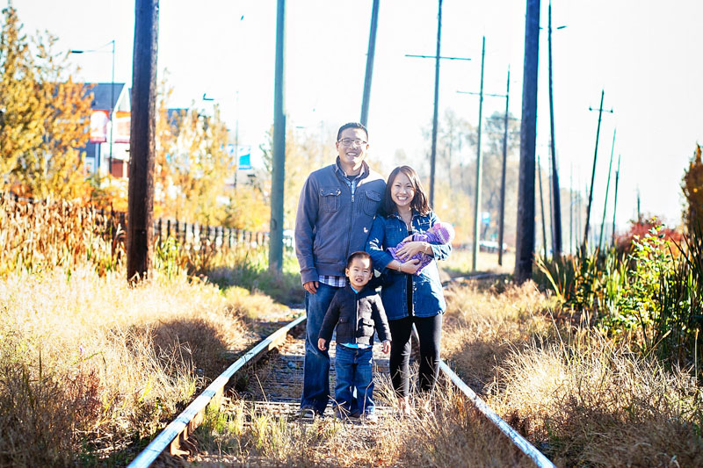
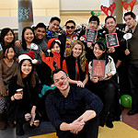
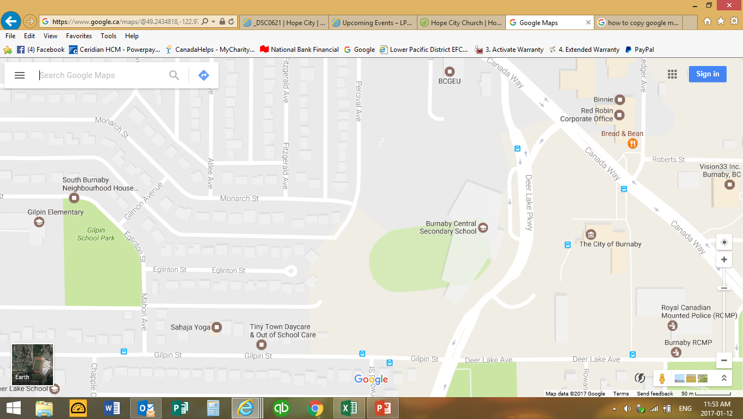
HOPE CITY CHURCH
Pastor Philip and Grace Yung
LPD church of the week
Praise points: 1. Growing young adults group 2. Able to send two members on missions this year, serving in China, Australia, Germany, and UK 3. Great leadership momentum with the creation of our Elders and Deacons teams.
Services held in Burnaby Secondary School

