Slide 1
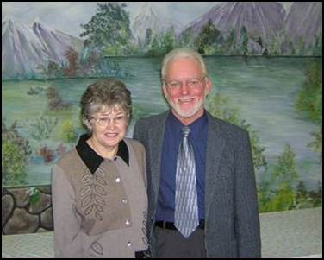
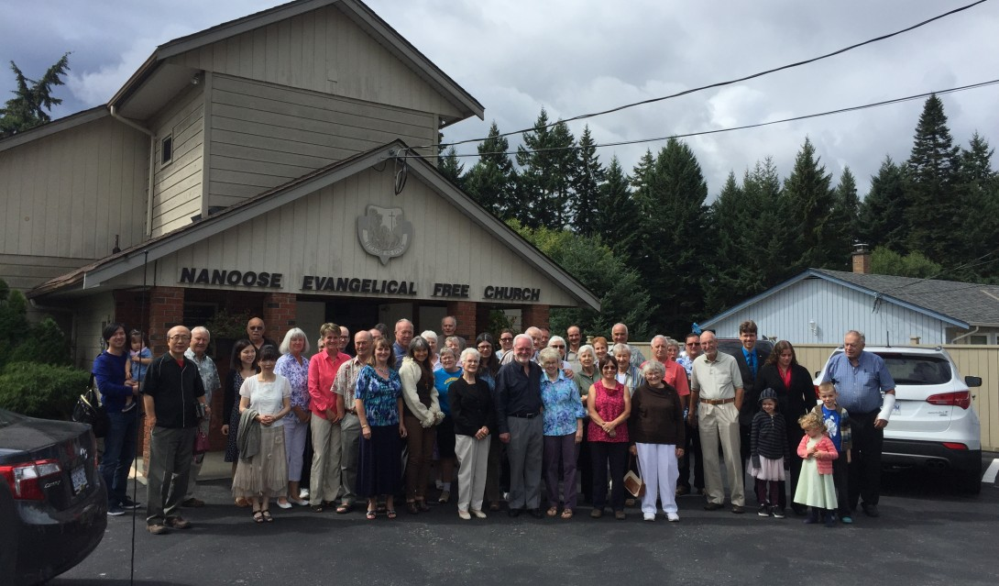
Praise: For several happy newcomers to our fellowship For recent major upgrades to our audio / video equipment Pray : For our upcoming AGM Feb 19th and for two people joining our membership and the appointment of a new elder Events: Bible seminar with Dr. Jerry Benjamin, Feb. 24th-26th
Nanoose EFC
LPD Church of the Week

