Slide 1
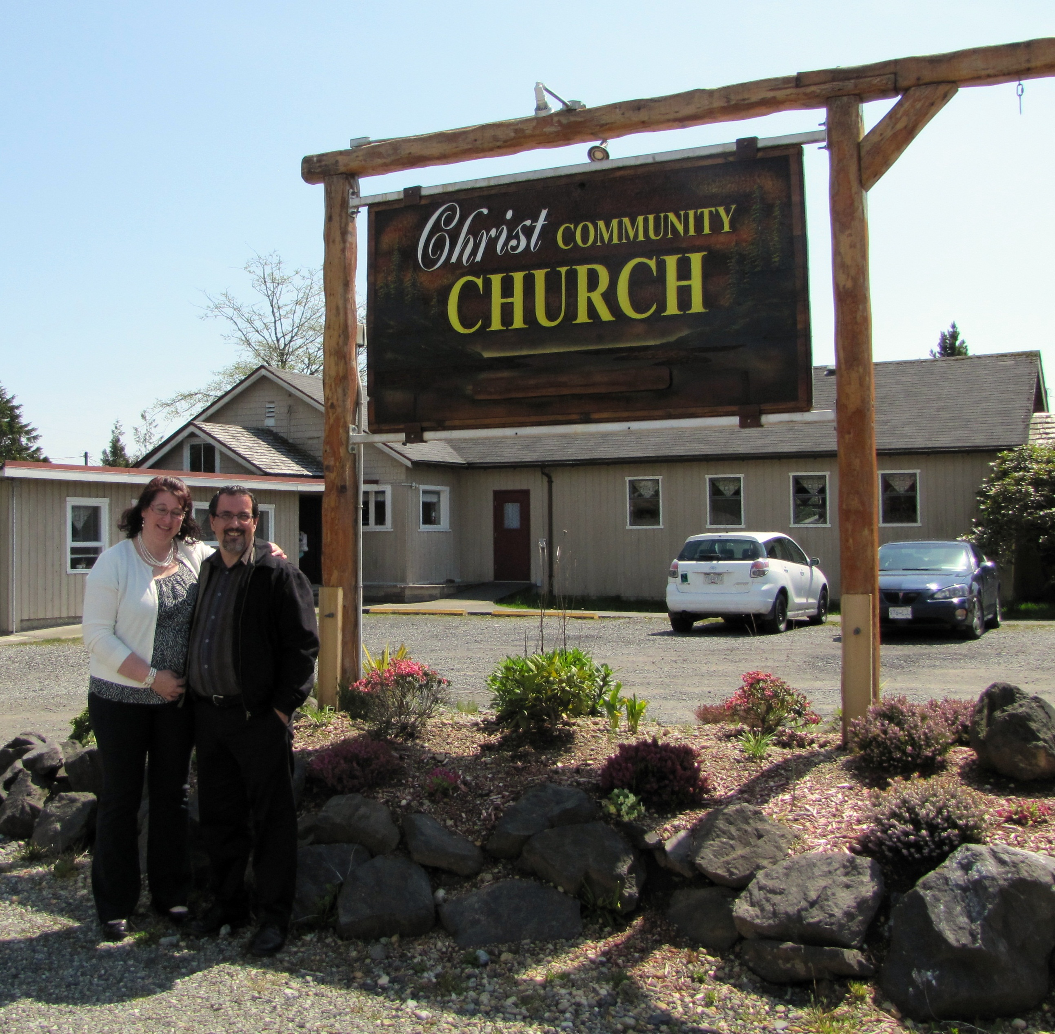
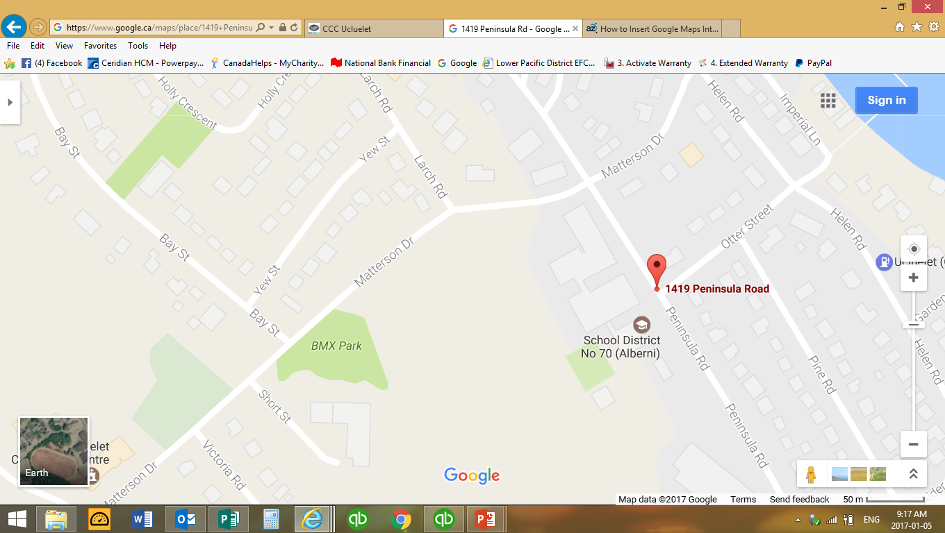
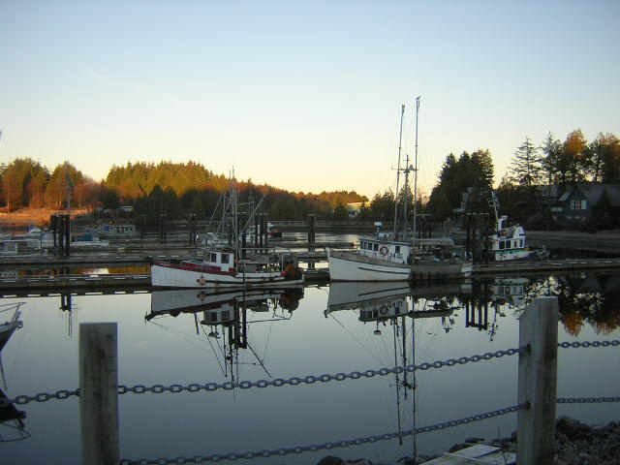
Christ Community Church
LPD Church of the Week
Please pray for:
Pastor Miles and Lorie White as they transition to a new direction
God’s will and direction in the installation of a new pastor.
God’s provision for suitable accommodation and financial stability for a new pastor to this area
1419 Peninsula Road, Ucluelet BC

