Slide 1
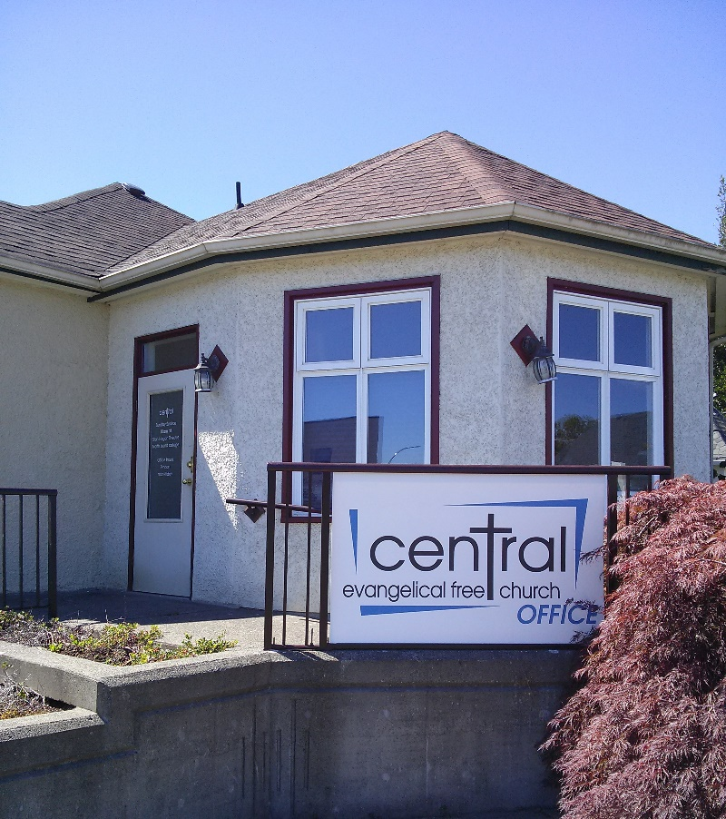
Central Evangelical Free Church
Church of the Week
In Courtenay BC (Vancouver Island)
Has been welcoming new members, and serving in the community and local schools, while caring for an aging congregational family through a season of much sickness. Please remember our health in your prayers, and our outreach to our friends and neighbours.

