Slide 1
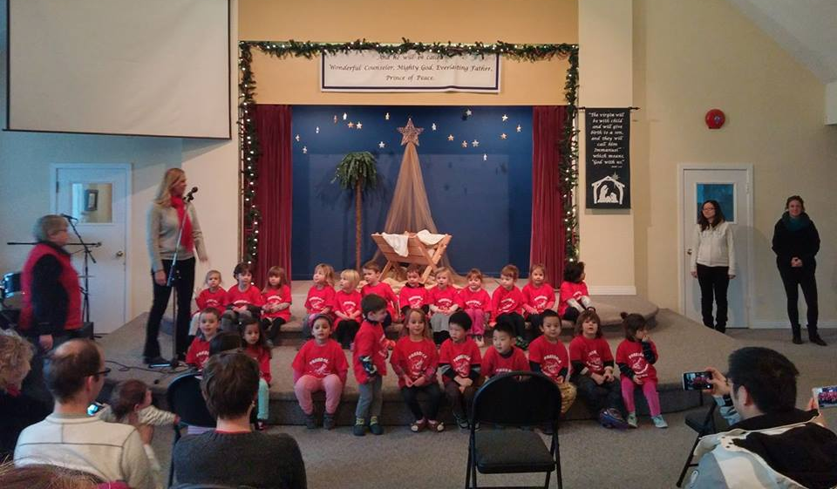
ParkDale evangelical Free Church
LPD Church of the Week
Victoria, BC
· Praise points
- new members, attenders, and small groups; new leaders elected
· Prayer requests
- clarity for how God is leading us to reach out to our community
- for a grant for a Summer Intern
· Upcoming/Recent Past events
- our Daycare and Junior Church both did Christmas concerts
- opportunities to start & host recovery ministries

